Slide 1
Automated On-Sun Analysis
Including module modeling and flux map characterization

Slide 2
Module Inputs
Calibration Constants/Experimental Config
Flux Map
  Module ART (spatial)
Module Design
  Optical Stack ART
  Design characteristics
Experimental Results

Slide 3
Calibration Constants:
Directly In Code
masking = 0.35
shading = 0.08 #on dish from receiver
mirror_loss = 0.11
#Calibration constants
PV_flow_cal = (20/3-2/6)/(5)
TR_flow_cal = 200/(5*60)
PV_pres_cal = 15/0.12
GHI_cal = 5000
DNI_cal = 0.00000776
Cp_water = 4.184
TR fraction = 0.57 #open area after CPV before receiver, estimated
TR efficiency = 0.95
CPV_mismatch = 0.085
Module Series Resistance = 0.126 Ohms
Cell_area = 0.0055**2

Slide 4
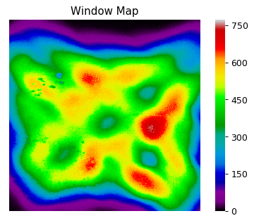
Flux Map:
Modeling/Flux_Maps
  58.5_844 DNI
Run with: OpticalFluxChar.py
Inputs
  Flux maps
    58.5_844DNI.xlsx (Mod 5, 6 position)
    65.0_515DNI.csv (Mod 7+ position)
  Aperture Size
  Module ART (optional)
Outputs:
  Flux maps (visual)
  Concentration maps (text)
  Module Spatial ART
  Module 6 Spatial ART
 | Cell | Bypass | Bypass w/Ch
Absorption | 0.6345 | 0.0491 | 0.0666
Reflection | 0.2445 | 0.0662 | 0.0808
Transmission | 0.121 | 0.8847 | 0.8526
  Mod6_58.5 Spatial ART
 | Bypass No Chan | Bypass Chan | Cells | Total
Power | 0.4329 | 0.2078 | 0.3592 | 1
A | 0.0212 | 0.0138 | 0.2279 | 0.2630
R | 0.0286 | 0.0167 | 0.0878 | 0.1332
T | 0.3829 | 0.1772 | 0.0434 | 0.6036

Slide 5
Module Design
Modeling/Module_Properties
Run with: CPVPerformance.py
Input
  Cell ART
  Cell Eff (hardcoded at 22% from John’s calc.)
  Module Design (encap thickness, cells, etc.)
Outputs
  Temp Maps
  Heat fraction
  Elec. Fraction
  Thermal Restiance

Slide 6
Experimental Results
Test_Data
Data Logger Header
Data Logger – Temperatures, Pressures, DNI
IV sweep data
IV sweep stats
MPP data
Following data shows the analysis of Mod6 Tests done on 1-23-18 using the 58.5_844DNI flux map

Slide 7
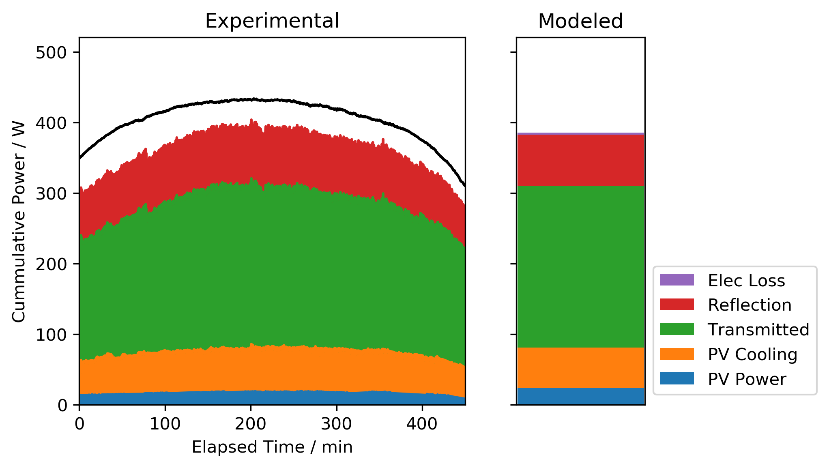
Outputs: Power flow analysis
 | Exp | Model | %delta
PV Cooling | 55.61 | 57.24 | -2%
PV Power | 15.63 | 23.94 | -34%
Reflection | 76.8 | 72.98 | 5%
Transmitted | 202 | 228 | -11%

Slide 8
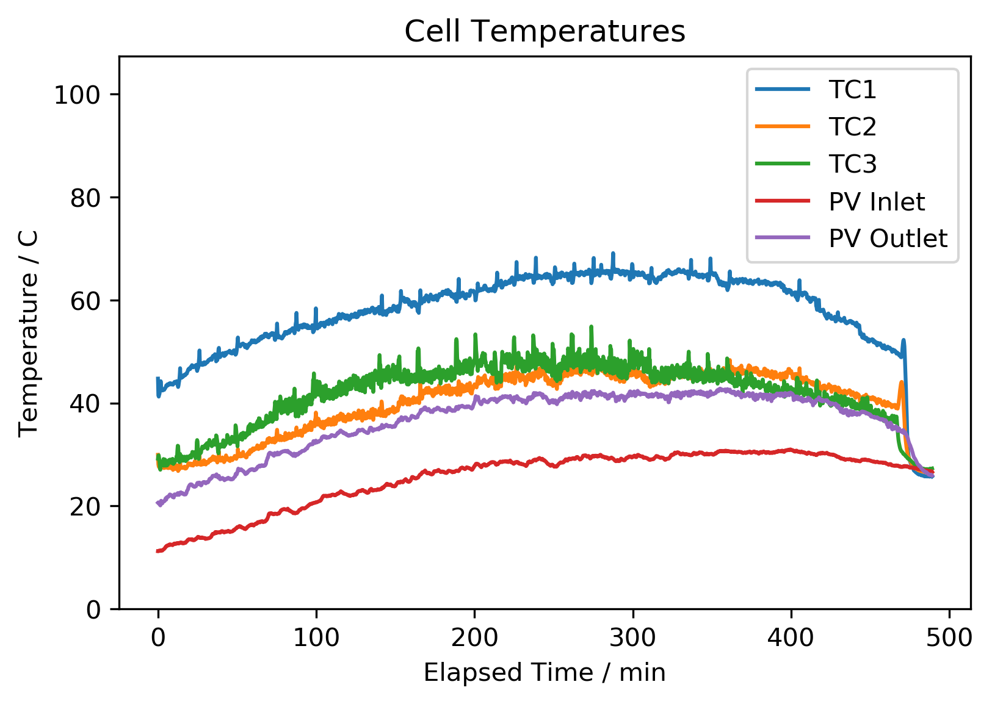
Cell Temperature
Predicted Temperatures
Loc. Conc. Temp (degC)
PV TC1 AB22 492 71.61
PV TC2 BC66 445 70.54
PV TC3 FG55 531 76.695
Avg None 459 71.6188

Slide 9
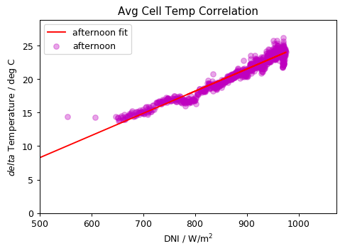
Thermal Resistance Calculation
Plots available for all other TCs as well
 | Conc. | Morn | Std err | Afternoon | Std err
Avg | 459 | 2.2 | 0.07 | 5.6 | 0.04
PV TC1 | 492 | 1.6 | 0.11 | 7.09 | 0.063
PV TC2 | 445 | 0.45 | 0.08 | 2.92 | 0.045
PV TC5 | 531 | 3.8 | 0.14 | 5.6 | 0.91

Slide 10
Updates
Easy
  Comparison of Thermal Resistance
  Comparison of Temperatures
  Jsc vs DNI plots
Slightly Harder
  Electrical characterization

Slide 11
Data to Check
Cell ART - Vera
Mod ART - Vera

Slide 12
Mod 6 Cell ART
 | Air-N-BK7 | N-BK7-Silicone | Silicone-Solar cell | Solar cell-Silicone | Silicone-Sapphire | Sapphire-Water | Water-N-BK7 | N-BK7-Air
In-band T | 0.9651 | 0.9648 | 0.8733 | 0 | 0 | 0 | 0 | 0
Out-of-band T | 0.9665 | 0.9662 | 0.8255 | 0.6772 | 0.6764 | 0.6658 | 0.6397 | 0.6228
Total T | 0.9656 | 0.9653 | 0.8574 | 0.2264 | 0.2261 | 0.2226 | 0.2138 | 0.2082
In-band R | 0.0349 | 0.0352 | 0.1241 | 0.1241 | 0.1241 | 0.1241 | 0.1241 | 0.1241
Out-of-band R | 0.0335 | 0.0338 | 0.1697 | 0.2 | 0.2007 | 0.2103 | 0.2112 | 0.2262
Total R | 0.0344 | 0.0347 | 0.1393 | 0.1495 | 0.1497 | 0.1529 | 0.1532 | 0.1582
In-band A | 0 | 0 | 0.0026 | 0.8759 | 0.8759 | 0.8759 | 0.8759 | 0.8759
Out-of-band A | 0 | 0 | 0.0048 | 0.1228 | 0.1229 | 0.1238 | 0.149 | 0.1509
Total A | 0 | 0 | 0.0033 | 0.6242 | 0.6242 | 0.6245 | 0.6329 | 0.6336
Inband A | 0 | 0 | 0.0026 | 0.8733 | 0 | 0 | 0 | 0
outofband A | 0 | 0 | 0.0048 | 0.118 | 0.0001 | 0.001 | 0.0252 | 0.0019
total A | 0 | 0 | 0.0033 | 0.6209 | 0 | 0.0003 | 0.0084 | 0.0006

Slide 13
Module 6 ART
  Module 6 Spatial ART
 | Cell | Bypass | Bypass w/Ch
Absorption | 0.6345 | 0.0491 | 0.0666
Reflection | 0.2445 | 0.0662 | 0.0808
Transmission | 0.121 | 0.8847 | 0.8526

